Slide 1


Basics of
LARAVEL

Slide 2

Introduction

Slide 3

HISTORY
Laravel, created by Taylor Otwell, was first released in June 2011. The framework aimed to provide an elegant and expressive syntax while offering modern features for web application development. Here's a brief history:
Version 1: Laravel 1 was released in 2011, introducing the basics of the framework and the foundations for subsequent versions.
Version 2: Released in September 2011, Laravel 2 brought improvements and new features, including support for controllers.

Slide 4
Version 3: Laravel 3, released in February 2012, featured a modular structure and support for third-party packages. It marked a significant step forward in terms of flexibility.
Version 4: Laravel 4, released in May 2013, introduced the Eloquent ORM and Laravel's migration system. It solidified Laravel's reputation as powerful and user-friendly framework
.Version 5: Laravel 5, released in February 2015, included the introduction of Laravel Elixir for asset compilation and Laravel Homestead for a pre-packaged development environment. This version focused on improving developer experience and performance
Version 6: Laravel 6, released in September 2019, continued to refine existing features and introduced improved job middleware, job events, and semantic versioning.
VERSION 7:Laravel 7 released in march 2020 introduced laravel airlock for API authentication,HTTP client improvements and laravel sanctum.
Version 8: laravel 8,released in september 2020,featured laravel Jetstream for scaffoldingapplication UIs, job batching, model factory classes, and improvements to job closures.
Version 9: Laravel 9, as of my last knowledge update in January 2022, had not been released. However, it was expected to bring further enhancements and features to the framework.

Slide 5

Objectives Of Laravel

Slide 6
Aims to provide a clean and elegant syntax while offering several key objectives:
Expressive Syntax: Laravel prioritizes code readability and a clean, expressive syntax to make development more enjoyable and efficient.
Modularity: It encourages modular development with features like Composer for dependency management, making it easier to organize and maintain code.
Eloquent ORM: Laravel includes Eloquent, an advanced implementation of the Active Record pattern, simplifying database interactions and providing a fluent query builder.
Blade Templating: Laravel's Blade templating engine allows for the creation of dynamic and reusable templates, promoting a clean separation of logic and presentation.
Artisan Console: Artisan, Laravel's command-line tool, provides various commands to automate repetitive tasks, making development and maintenance more streamlined.
Database Migrations and Seeding: Laravel simplifies database management through migrations, allowing developers to version-control database schema changes, and seeding for populating databases with test data.
Middleware: Middleware in Laravel enables you to filter HTTP requests entering your application, providing a flexible way to handle tasks like authentication and logging.
Routing System: Laravel offers a simple and expressive routing system that helps in defining web and API routes with ease.
Dependency Injection and IoC Container: Laravel utilizes dependency injection and an Inversion of Control (IoC) container, making it easier to manage class dependencies and enhance code testability.
Testing Support: Laravel supports PHPUnit for testing applications, promoting test-driven development (TDD) and ensuring code reliability.

Slide 7
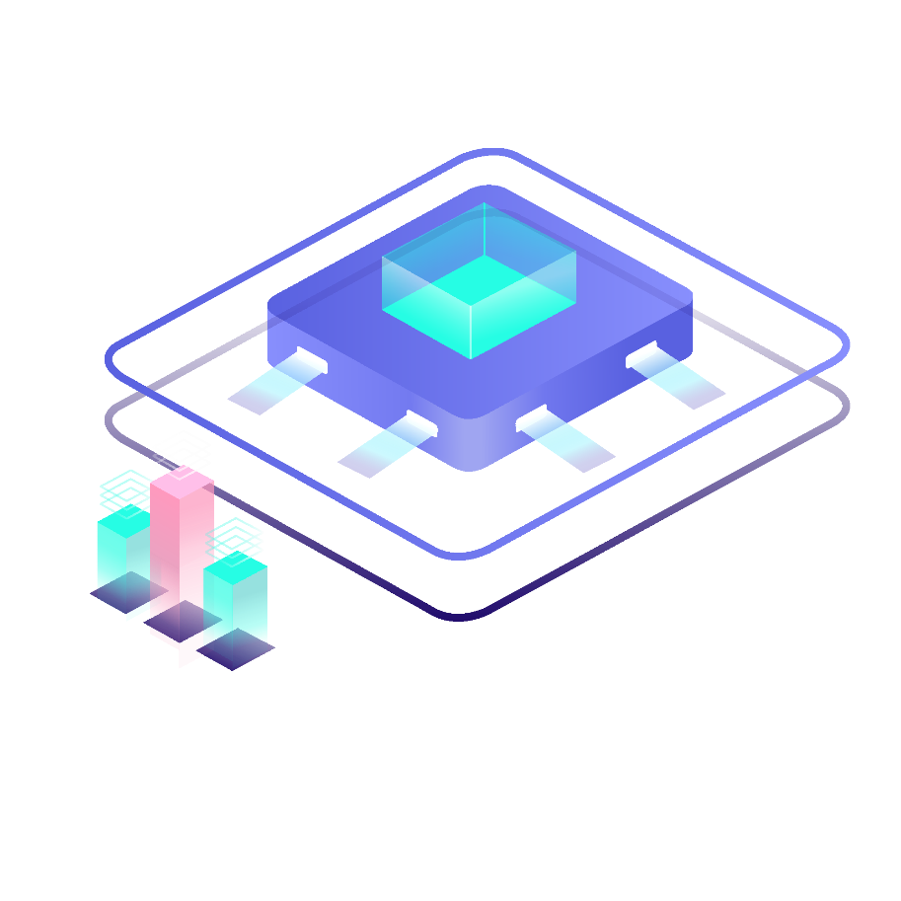
Body and content

Slide 8



Laravel application is structured and managed through various components:

Slide 9
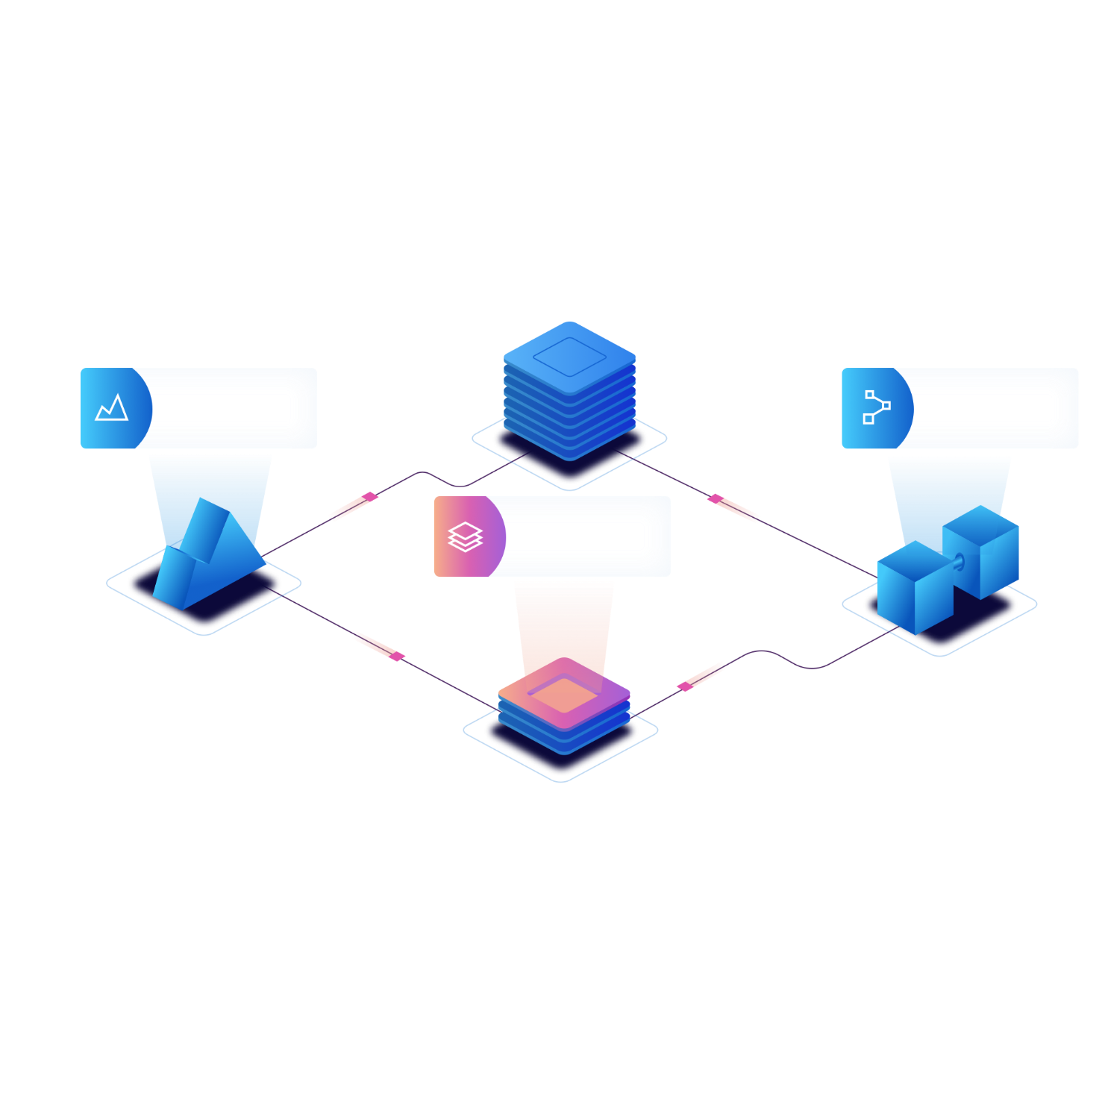
A
B
Views: Laravel uses the Blade templating engine to create dynamic and reusable views. Views define the HTML structure and include placeholders for dynamic content.
Controllers: Controllers handle the application's logic and interact with models and views. They receive user input, process data, and pass information to the views.

Slide 10

C
MODELS
Models represent the data structures and business logic of the application. They interact with the database through Eloquent, Laravel's ORM, to retrieve and store data.
D
ROUTES
Laravel's routing system defines how HTTP requests are mapped to controllers and actions. Routes determine the flow of requests through the application
E
MIDDLEWARE
Middleware in Laravel allows you to filter HTTP requests entering your application. It can be used to perform actions before or after the request reaches the controller, such as authentication or logging.

Slide 11
F
ELOQUENT ORM
Laravel's Eloquent ORM simplifies database interactions by providing an intuitive syntax for querying databases. Models use Eloquent to retrieve, insert, update, and delete records.
G
BLADE TEMPLATES
Blade templates are used to define the HTML structure of views. They support features like template inheritance, control structures, and include directives for creating dynamic and modular views.

Slide 12
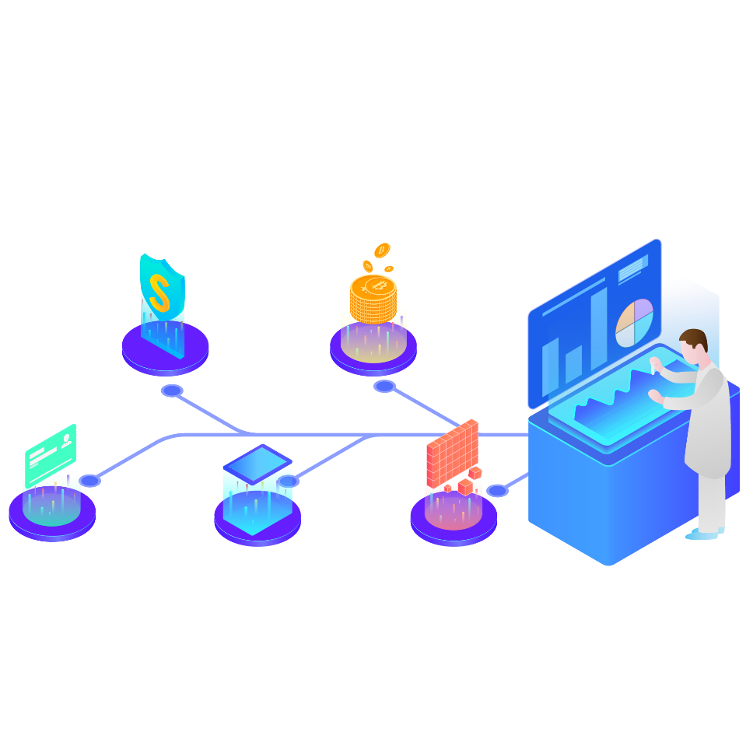
Outline structure

Slide 13


Steps on how to create laravel project
laravel

Slide 14
Step 1: install composer.
Ensure you have composer,as laravel uses it for package management. You can download it from getcomposer.org.
Step 2: install laravel.Open a terminal and run the following command to create a new laravel project:
Composer create-project –prefer-distlaravel/laravel project –name
Step 3: navigate to the project.Move into your newly created project directory.
Cd project-name
Step 4: configure environment.Copy the .env.example file to a new file named .env. Update the database connection and other settings in the .env file.
Step 5: generate application key.Run the following command to generate an application key.
Php artisan key: generate
Step 6: database migration.Migrate the database tables.
Php artisan migrate

Slide 15
Step 7: serve the application
Start the development server
Php artisan serve
Now you can access our laravel application in browser at http://localhost: 8000

Slide 16
Laravel uses a clean and expressive syntax. Here are some key syntax elements:
1.Routing : define routes in routes/web.php or routes/api.php:
Route: :get (‘/example’,’Examplecontroller@index’);
2.Controllers : create controllers in the app/Http/controllers directory:
Php artisan make:controller
ExampleController
then define methods within the controller.
3.Views : blade templating engine is used for views. Create views in resources/views:
<! - - Blade syntax - ->
{ { $variable } }
@if (condition)
// code
@endif

Slide 17
4. Models : define models in app directory;
Php artisan make: model Example
5.Eloquent ORM: laravel’s ORM for databases interactions:
$examples = Example: :all( );
6. Database migrations: create and run migrations to manage database schema:
Php artisan make:migration
Create_examples_table
Php artisan migrate
7. Middleware : use middleware to filter HTTP requests:
Public function handle ($request, Closure$next)
{
// code
return $next( $request);
}

Slide 18
8. Blade layouts: create layouts for reusable views:
@extends (‘layouts.app’)
@section (‘content’)
// content
@endsection
9.Form validation: validate input data in controllers:
$validatedData = $request-> validate ( [
‘name’=> ‘required I max:255’,
‘email’=> ‘required I email’,
]);
10. Dependancy injection : inject dependencies into controllers or services:
Public function _construct(ExampleServices $service)
{
$this ->services = $service;
}

Slide 19
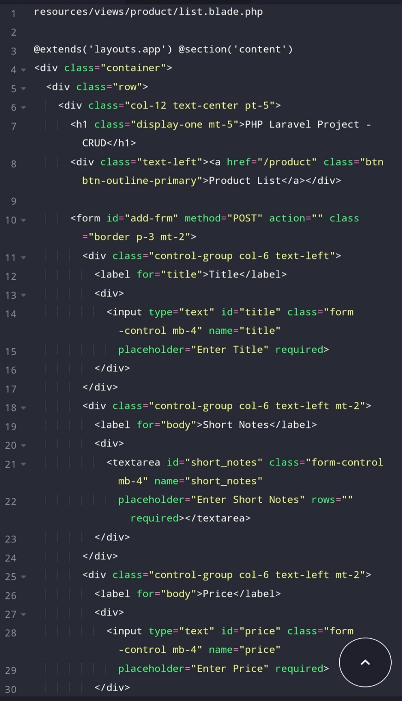
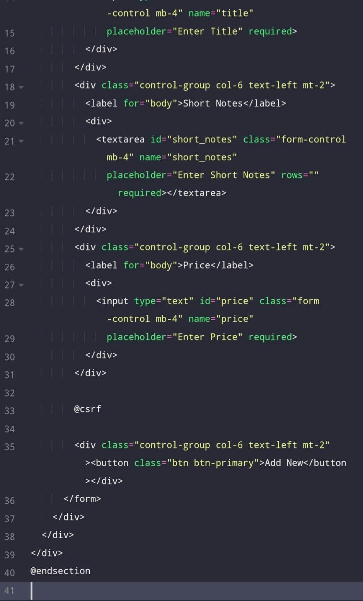
Example
Laravel
Code

Slide 20
THANKS

